Slide 1
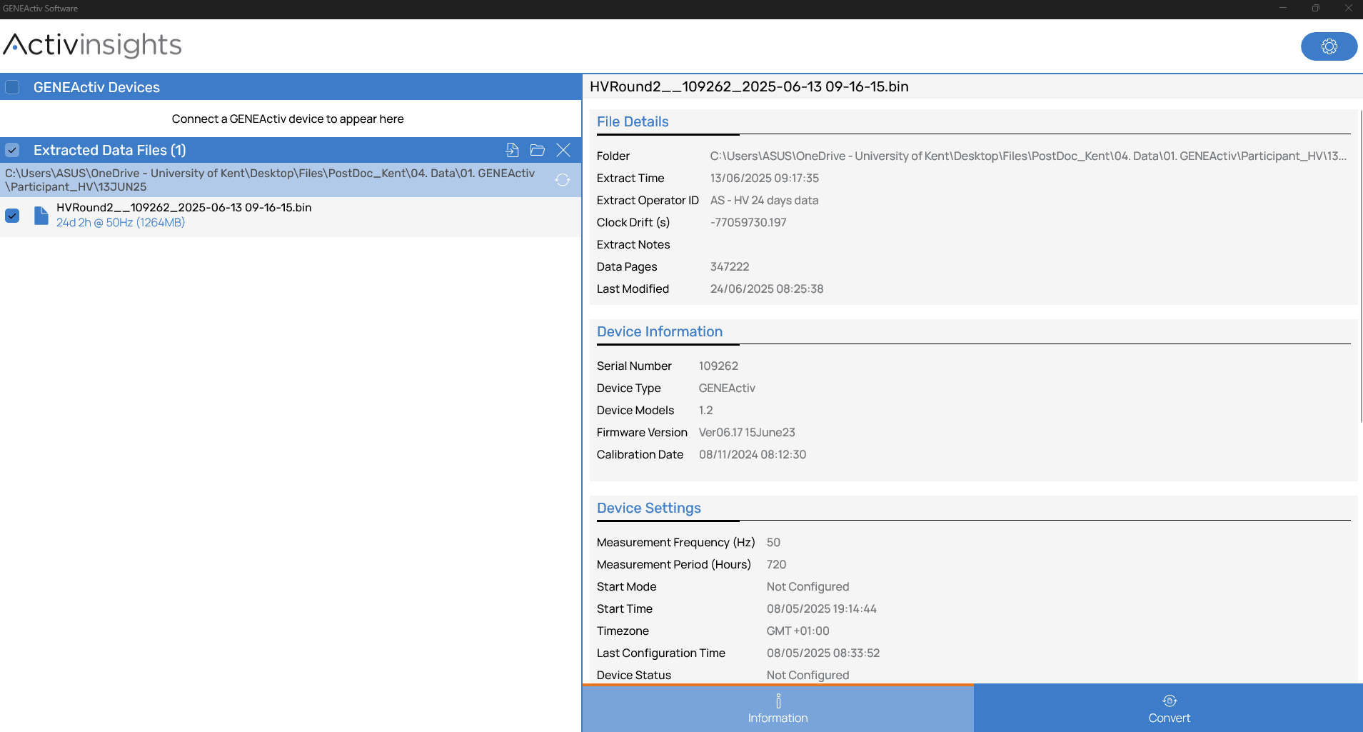
1. Select extracted data from the GENEActiv software

Slide 2
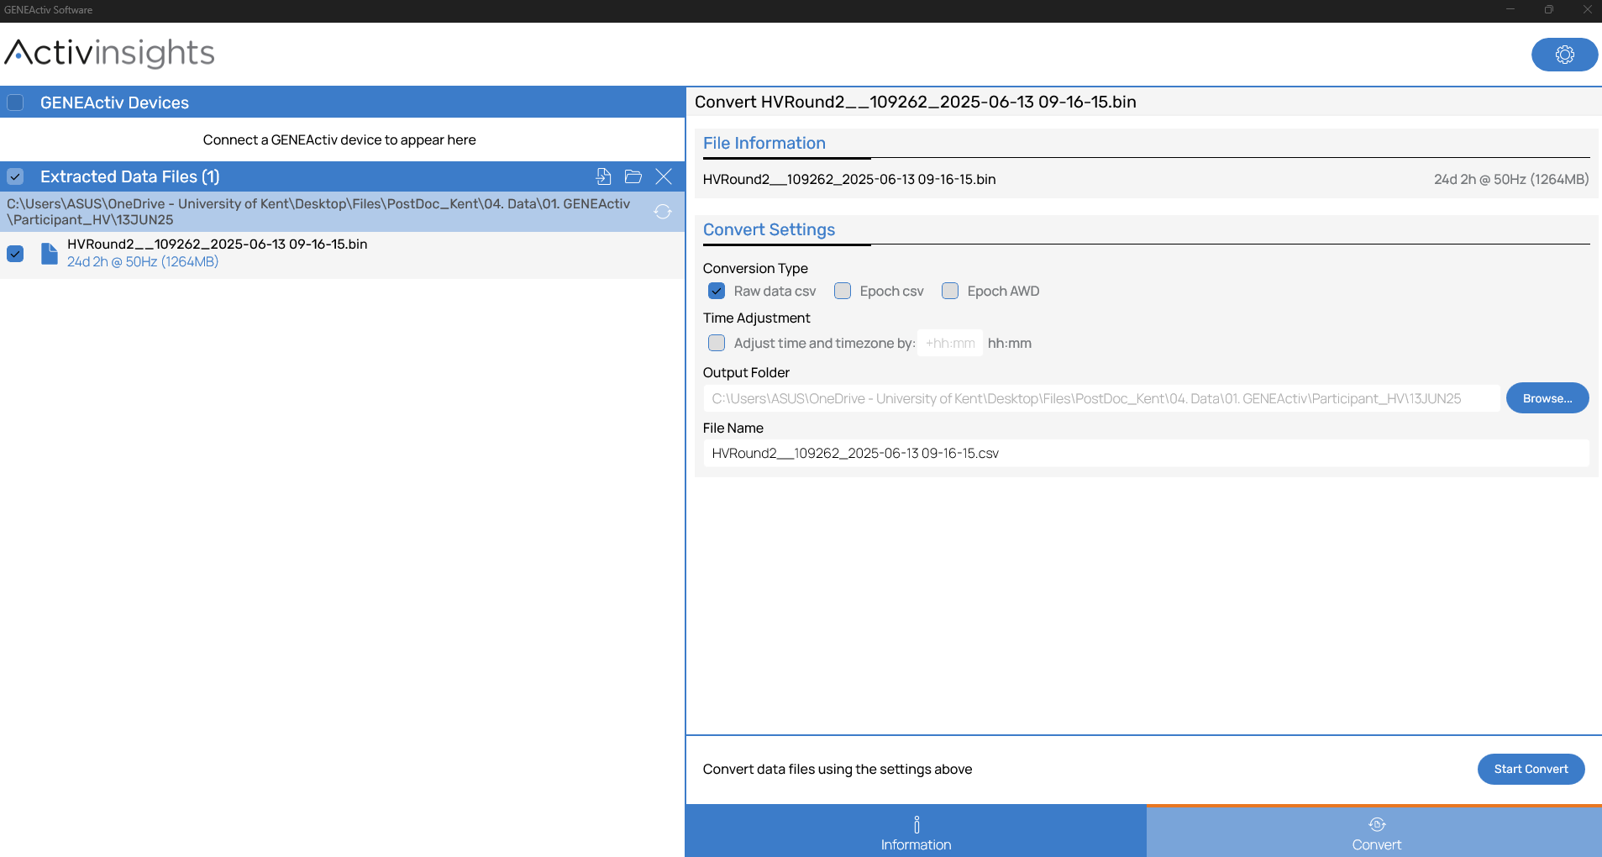
2. Go to the “Convert” tab
3. Check it’s the correct file
4. Select “Raw data csv” and ensure it’s the correct “Output folder” and “File Name”

Slide 3
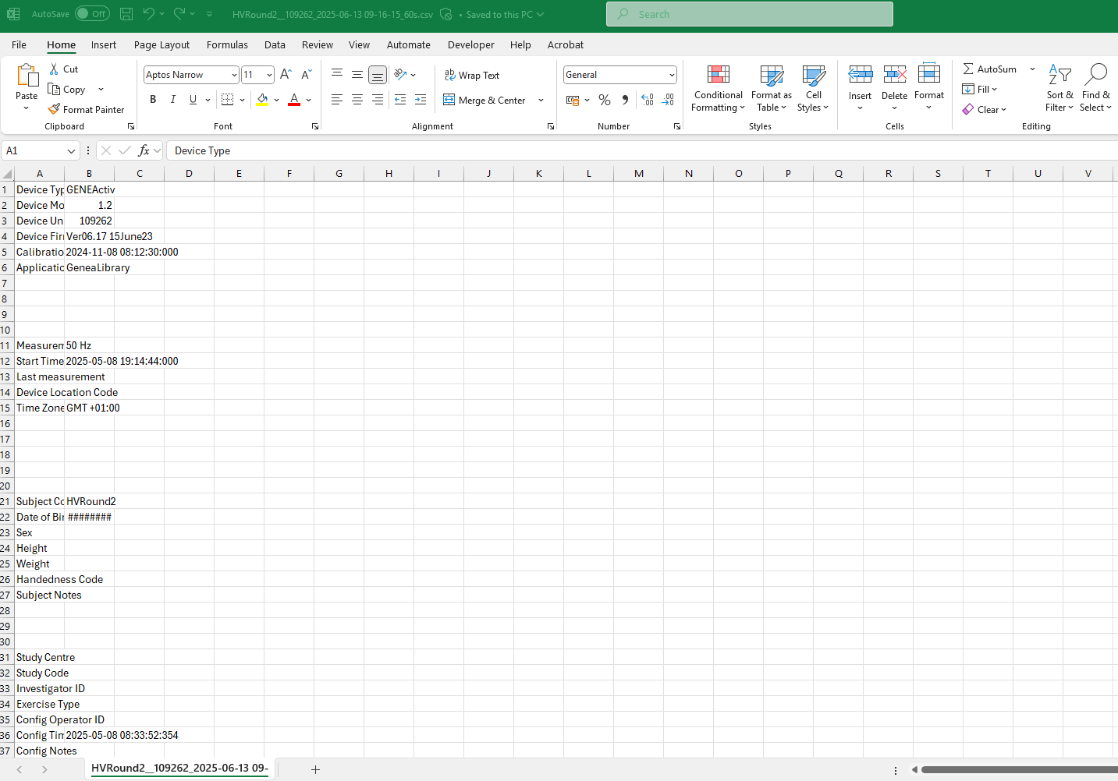
5. Open the csv file and scroll down to the raw data

Slide 4
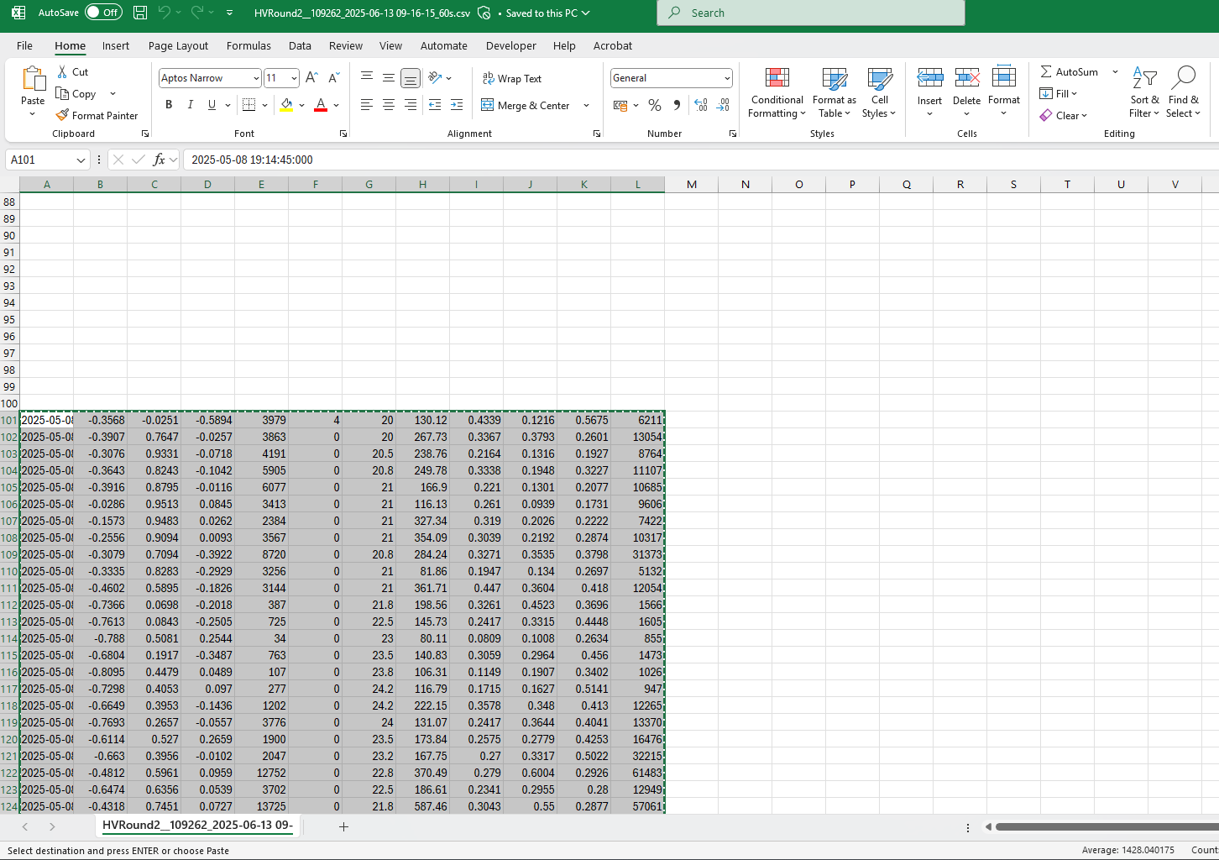
6. Copy the raw data

Slide 5
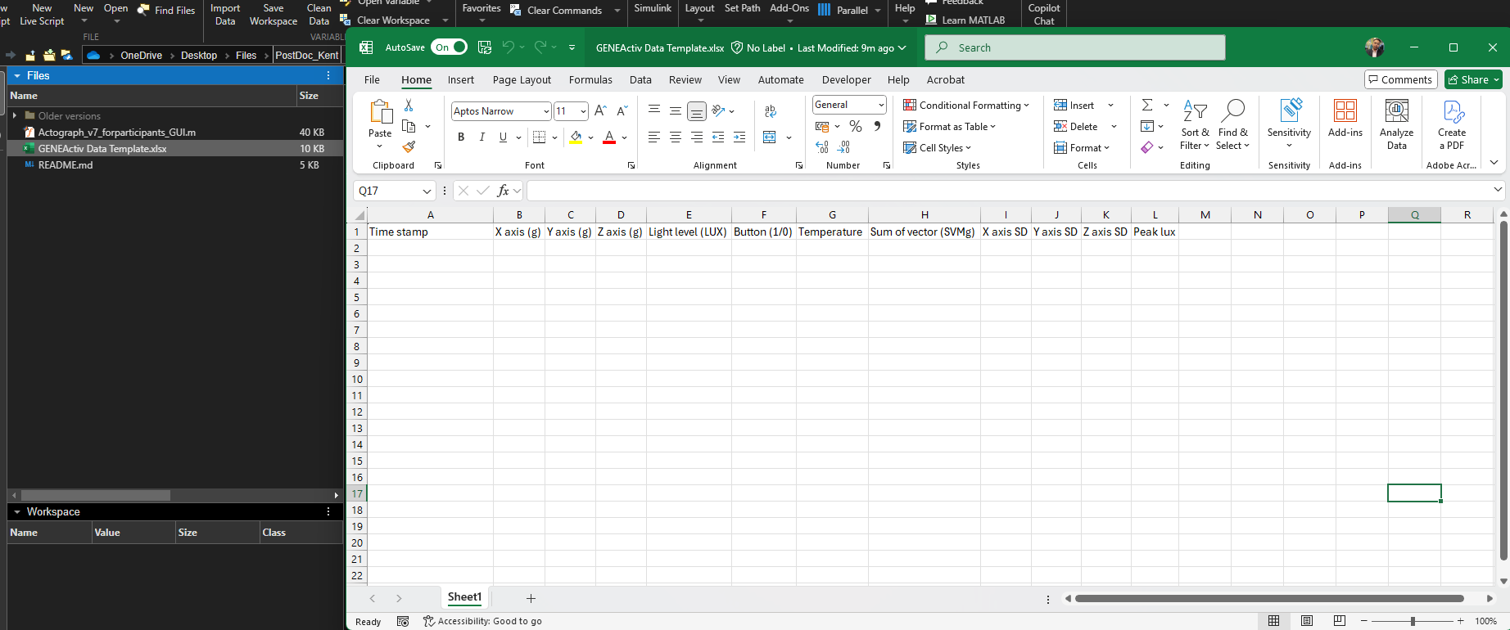
7. In the “GENEActiv_Data Visualisation codes”, open the “GENEActiv Data Template.xlsx

Slide 6
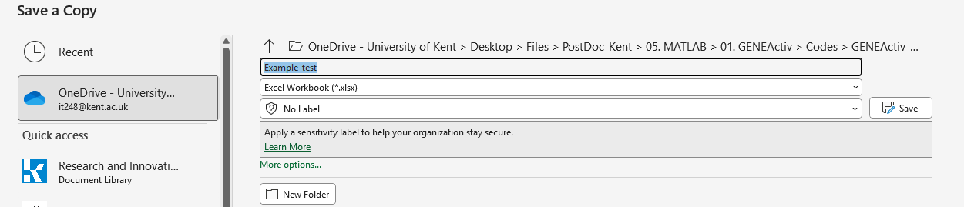
8. Ensure to save a local copy before pasting any raw data

Slide 7
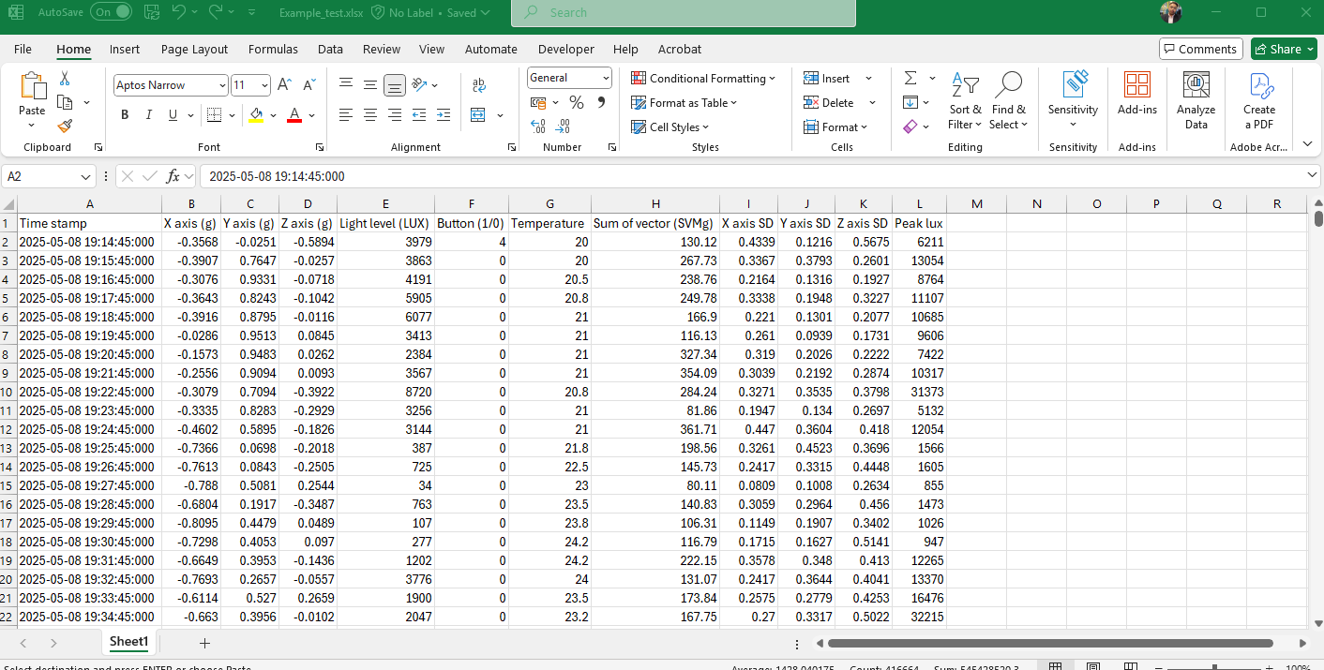
9. Paste the raw data to your saved file

Slide 8
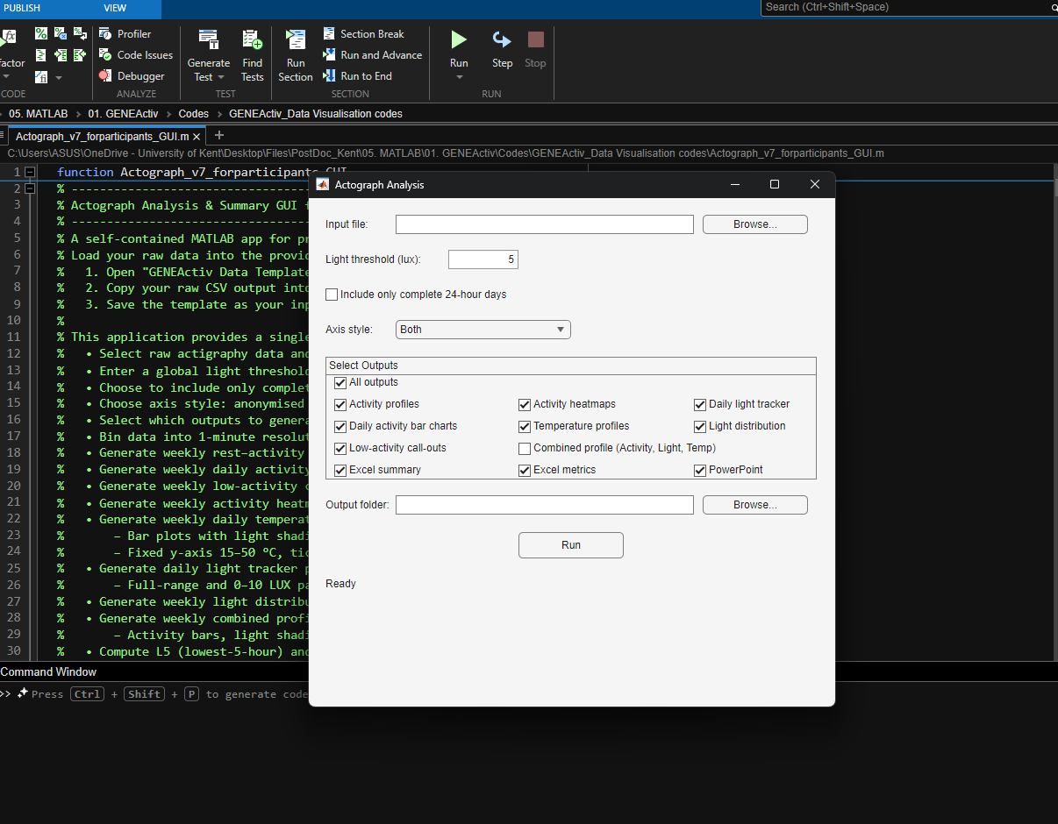
10. Click “Run”
11. Select your file
12. Adjust light threshold
13. Select if the output should include all the dataset or just complete 24-hour days
14. Select axis styles, either just in “Days” or “Dated”, or both
15. Select the outputs desired
16. Select desired output folder and click “Run”

